Slide 1
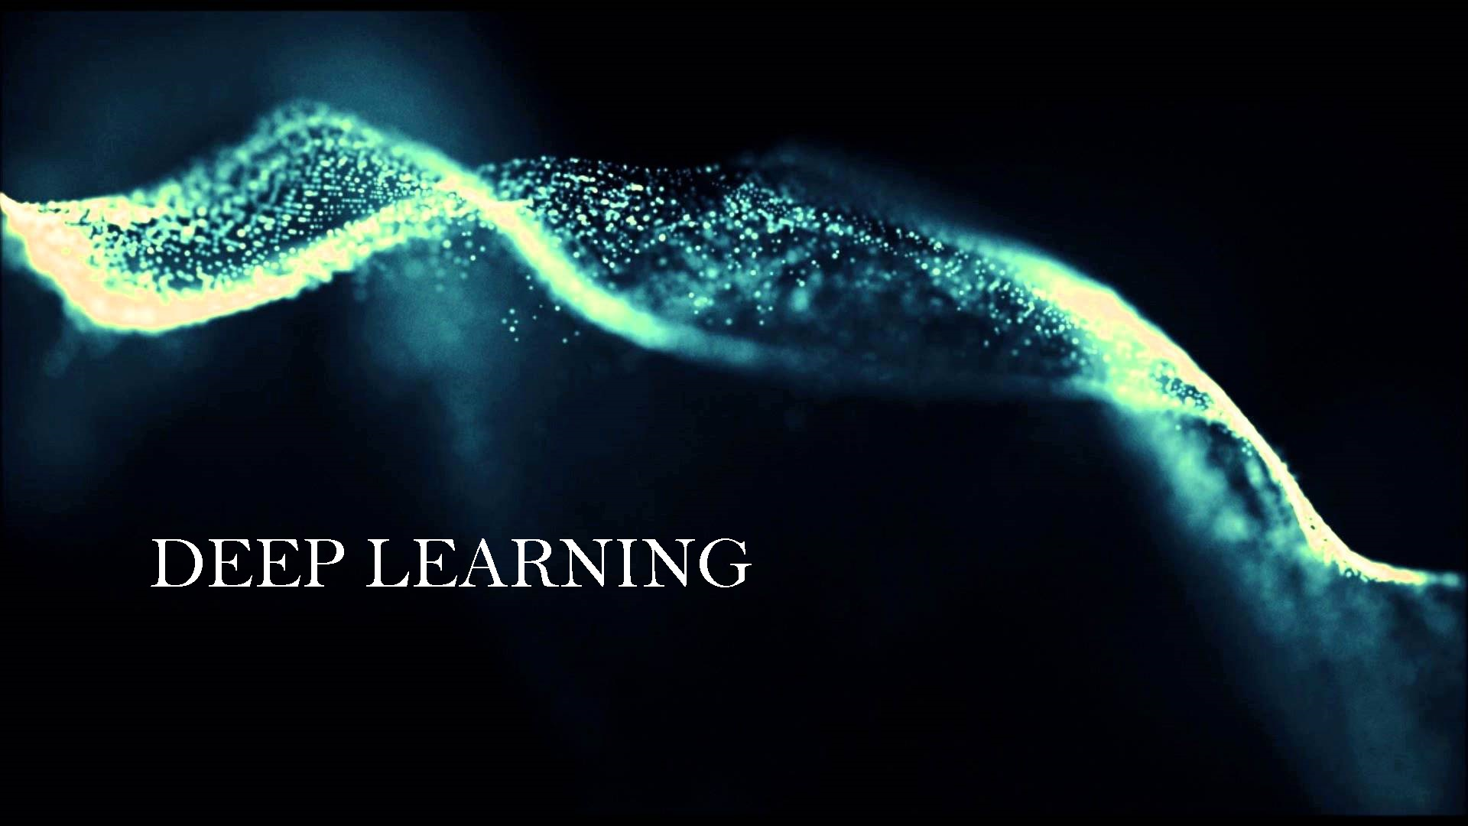

Slide 2
Introduction
1 minute deep learning intro
7 minutes CNN
3 minutes Project
4 minutes Implementation
1 minute about challenges
1 minute future: datasets, resources, online challenges
3 mins Questions

Slide 3
DEEP learning
Goal: No need of hand-crafted feature set
Unsupervised Pretrained Networks
CNN -Convolutional Neural Networks
RNN - Recurrent Neural Networks
Recursive Neural Networks

Slide 4
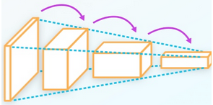
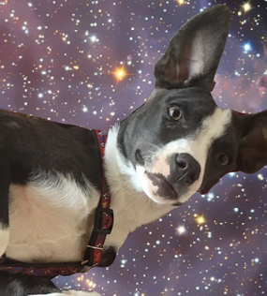
Convolutional Neural Network
Dog Breed Classification

Slide 5
WhY CNN
Good at Image Classification
In 2012, Ciresan et al. significantly improved on the best performance in the literature for multiple image databases

Slide 6
WHAT is CNN
Convolutional Neural Network: A special type Neural Networks that works in the same way of a regular neural network except that it has a convolution layer at the beginning

Slide 7
CNN Basics
Convolutional Layer
Pooling
Dense Layer = Fully Connected Layer
Dropout Layer

Slide 8
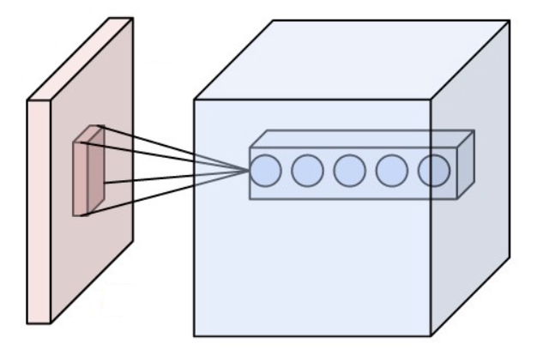
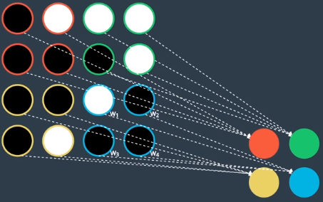
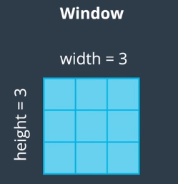
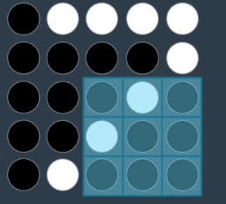
Convolutional Layer

Slide 9
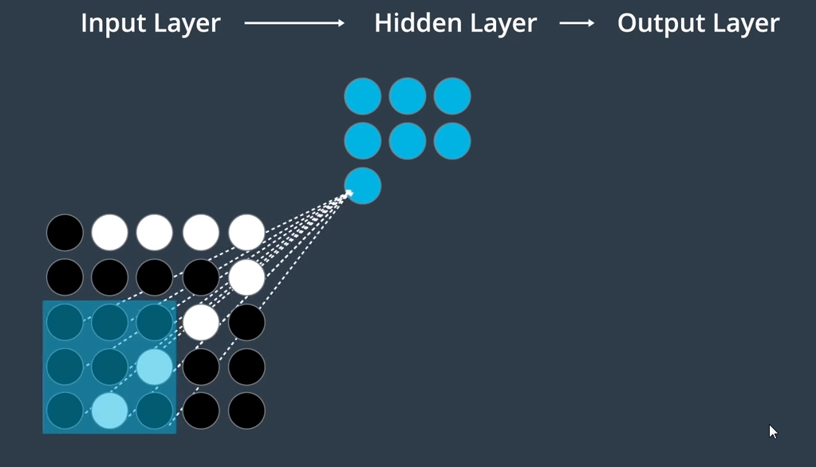
Convolutional Layer

Slide 10
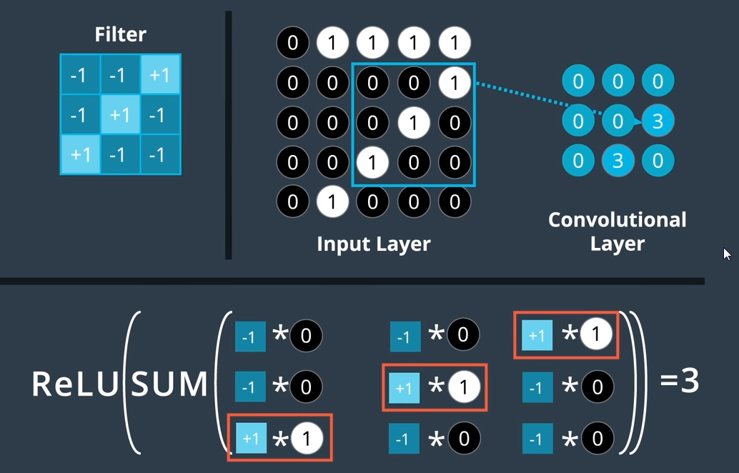
Convolutional Layer

Slide 11
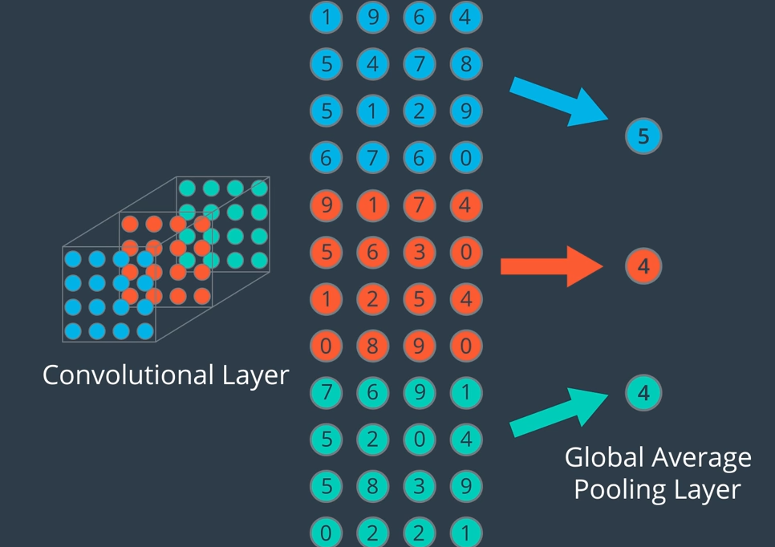
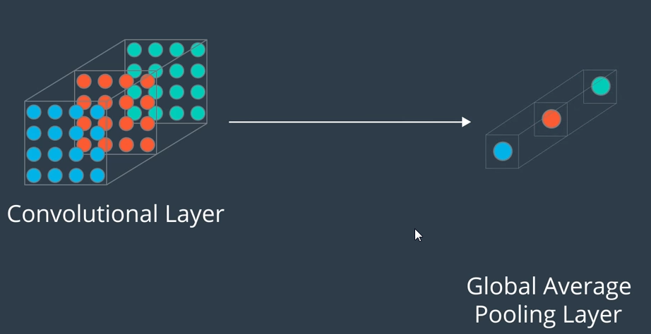
Pooling
Reduce the dimensionality; we do not want overfitting

Slide 12
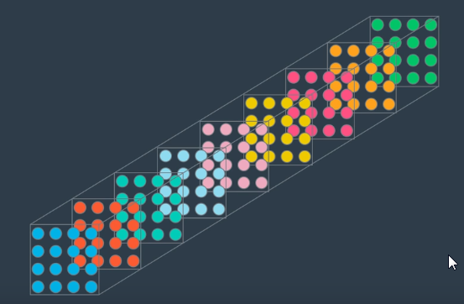
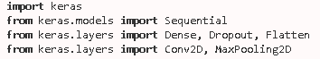
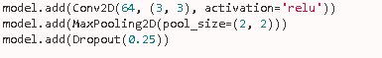
CNN Architectures
Stacking of different layers
Final Layer holds the classification features

Slide 13
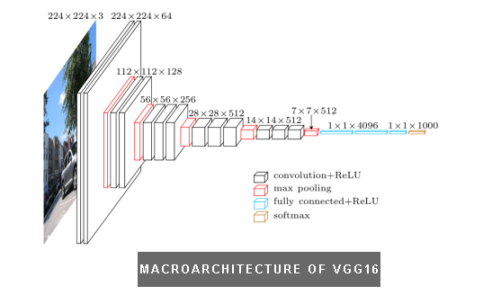
CNN Architechture: VGG 16
This network is characterized by its simplicity, using only 3×3 convolutional layers stacked on top of each other in increasing depth. Reducing volume size is handled by max pooling. Two fully-connected layers, each with 4,096 nodes are then followed by a softmax classifier

Slide 14
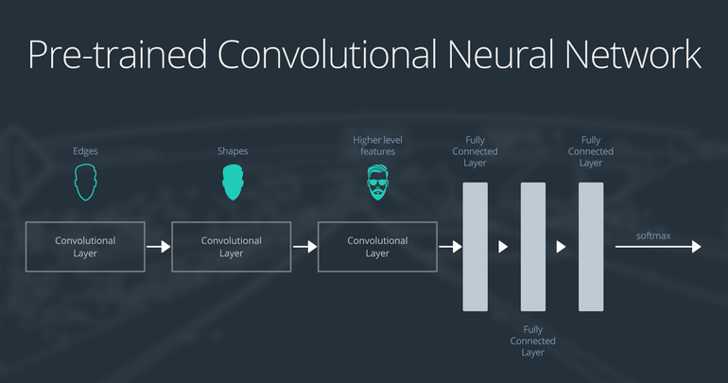
Transfer Learning
Transfer learning involves taking a pre-trained neural network and adapting the neural network to a new, different data set.

Slide 15
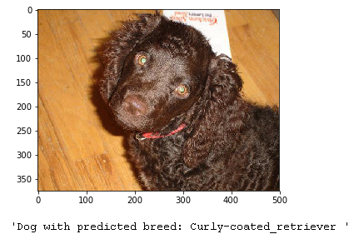
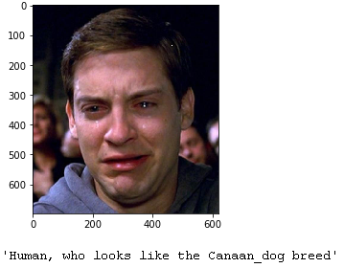
DOG Breed ClassiFication
Problem Statement
if a dog is detected in the image, return the predicted breed.
if a human is detected in the image, return the resembling dog breed.
if neither is detected in the image, provide output that indicates an error.

Slide 16
Given; requirements
Given:
Train, Validate and Test Images of Dog
Human Images
Ipython files: Code
Pre-trained Models: VGG 16
Requirements:
opencv-python==3.2.0.6h5 py==2.6.0
matplotlib==2.0.0 numpy==1.12.0
scipy==0.18.1 tqdm==4.11.2
keras==2.0.2 scikit-learn==0.18.1
pillow==4.0.0 ipykernel==4.6.1

Slide 17
Implementation
Model Architetctures VGG 16, VGG19,ResNet 50, Xception, Inception
Transfer Learning - To reduce training time without sacrificing accuracy.
The model uses the pre-trained VGG-16 model as a fixed feature extractor, where the last convolutional output of VGG-16 is fed as input to our model.
We only add a global average pooling layer and a fully connected layer, where the latter contains one node for each dog category and is equipped with a Softmax Activation Layer.

Slide 18
Implementation
: Import Dataset
: Extract the features from Pre-trained Model
: Define your Architecture
: Compile the Model
: Train the Model
: Load the Model with best Validation Loss
: Test the Model

Slide 19
Issues setting up
Laptop memory: 8 GB, GPU
Time per epoch: 7 Hours on Laptop
Installing requirements

Slide 20
How to go forward
Tutorials TensorFlow, Theano
Datasets ImageNet, Kaggle, DL4J, UCI Machine Learning
Online Challenges Kaggle, ImageNet Large Scale Recognition Challenge
Resources Deep Learning Book
Blogs No Free Hunch, Towards Data Science, Medium
Reddit Machine Learning WAYR

Slide 21
References
https://medium.com/@tifa2up/image-classification-using-deep-neural-networks-a-beginner-friendly-approach-using-tensorflow-94b0a090ccd4
https://www.cs.toronto.edu/~frossard/post/vgg16/
https://en.wikipedia.org/wiki/Convolution
https://en.wikipedia.org/wiki/Convolutional_neural_network
http://www.deeplearningbook.org/
https://www.pyimagesearch.com/2017/03/20/imagenet-vggnet-resnet-inception-xception-keras/
https://www.tensorflow.org/tutorials/
https://towardsdatascience.com/machine-learning-with-tensorflow-on-google-cloud-platform-code-samples-7c1bc07cd265
https://arxiv.org/pdf/1411.1792.pdf

Slide 22
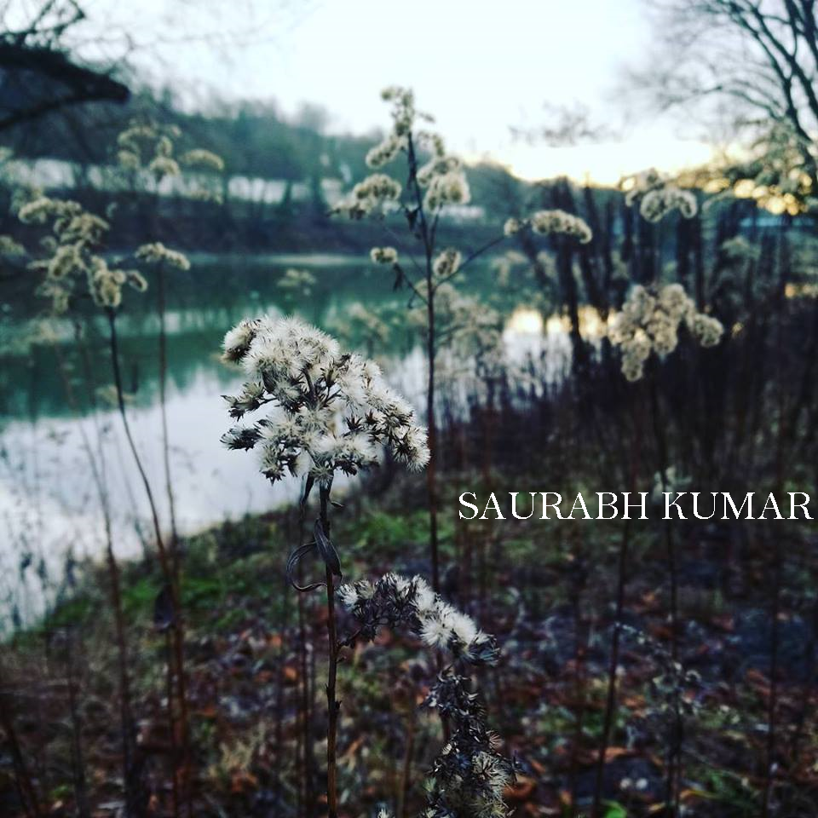
Remarks & Questions
Vielen Dank
Remember that the practice is far ahead of the theory in deep learning. Experiment with many different architectures, and trust your intuition. And, of course, have fun!
☺

